Slide 1
Design and Evaluation of Beyond 5G Wireless Communication Systems
Xinyuan xu (james)
4th year MEng
Notes:
Introduction of myself
Comm and SP: Huawei

Slide 2
Index
Introduction
Rate Splitting
Why
What
How
Alternating Optimization
Rate Splitting with Partial CSIT
Experiment on the Optimization Feasibility
Reflection

Slide 3

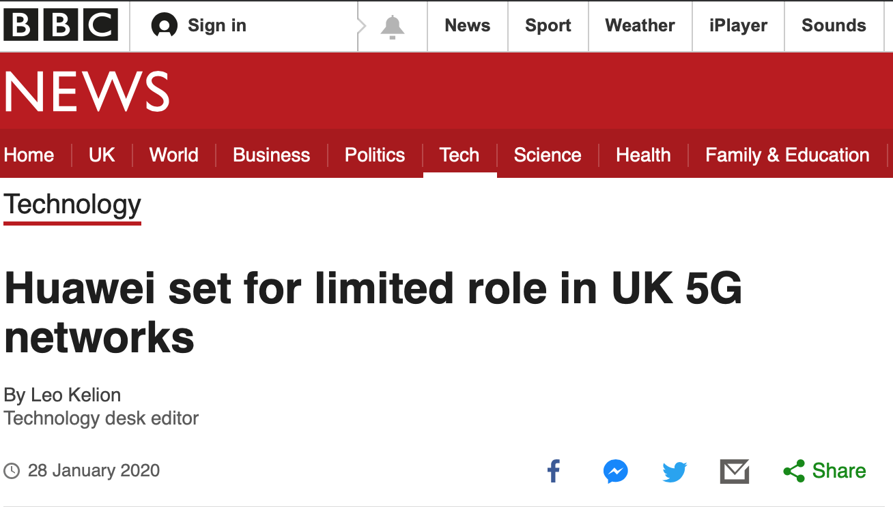
Introduction(1)
Notes:
The UK has decided to let Huawei continue to be used in its 5G networks but with restrictions, despite pressure from the US to block the firm.
5g mobile using experience

Slide 4

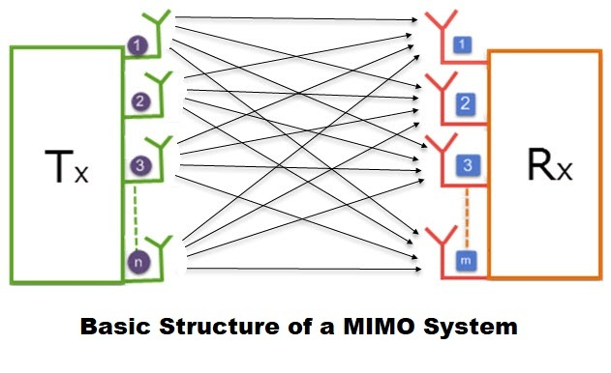
Introduction(2)

Slide 5
Rate Splitting - why
“The advantages above unfortunately come at a price.”
Channel State Knowledge at transmitter
Amount
Accuracy
Inaccuracy => multi-user Interference

Slide 6


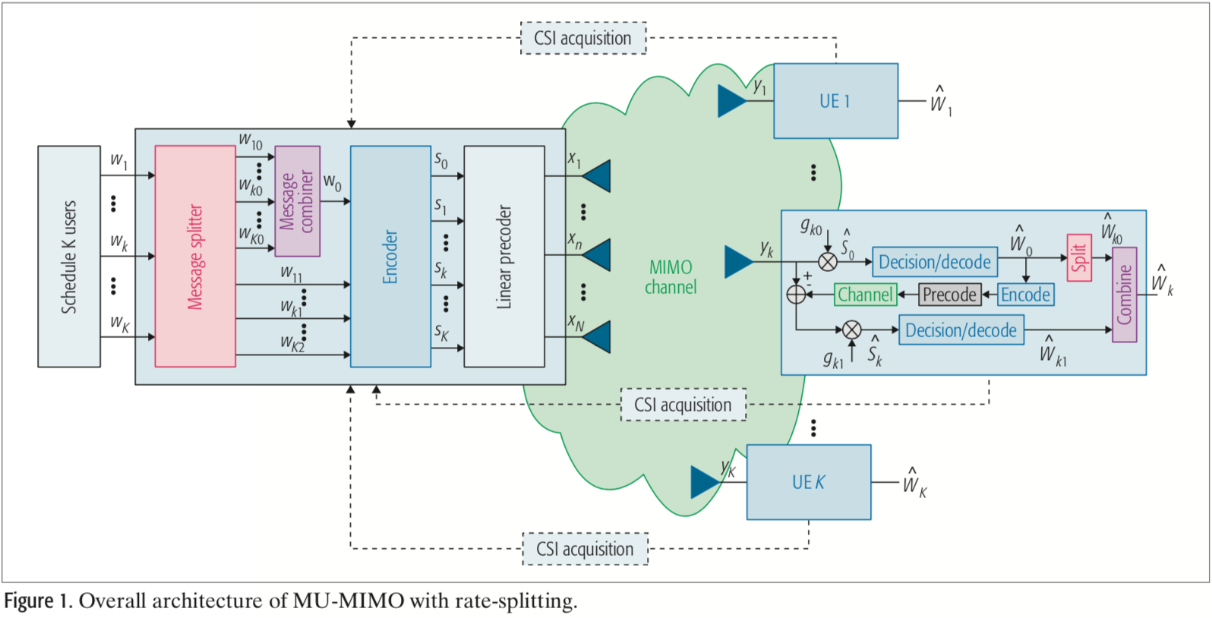
Rate Splitting - what
Origin: two-user interference channel by Charleial, Han and Kobayashi
Downlink / Broadcast Channel
Common and private message
Successive Interference Cancellation
Notes:
Rate Splitting for MIMO Wireless Networks: A Promising PHY-Layer Strategy for LTE Evolution
Bruno Clerckx, Hamdi Joudeh, Chenxi Hao, Mingbo Dai, and Borzoo Rassouli

Slide 7
Rate splitting - how
NOMA:
SC-SIC
Fully decode interference
SDMA:
MU-LP
Fully treat (residual) interference as noise
Rate Splitting: flexible between the 2 extremes
Table 1, Rate-splitting multiple access for downlink communication systems: bridging, generalizing, and outperforming SDMA and NOMA by Yijie Mao, Bruno Clerckx and Victor O.K. Li1

Slide 8
Alternating Optimization / WSRBF-WMMSE
Weighted Sum-Rate Maximization using Weighted MMSE for MIMO-BC Beamforming Design
Alternative Optimization
MULP: Linear transmit filter design
WSR
MIMO-BC
Non-convex
Complexity
Beamformer, MMSE receive filter, weight matrix of user-k

Slide 9
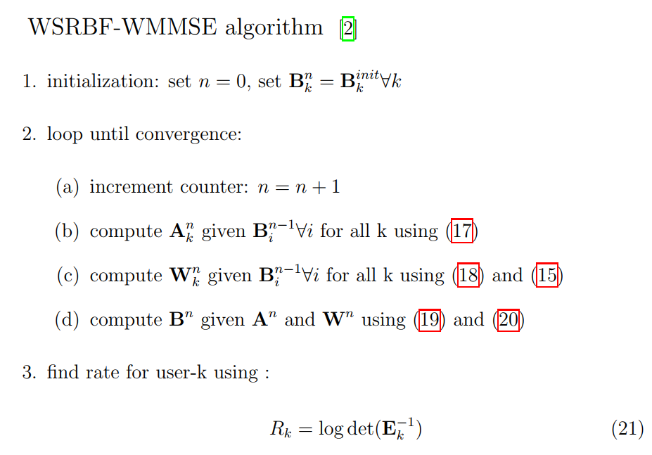
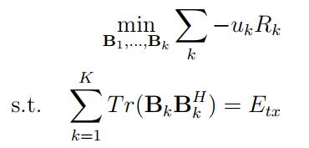
Problem & algorithm
Notes:
B: transmit filter
A: MMSE receive filter
W: weight matrix

Slide 10
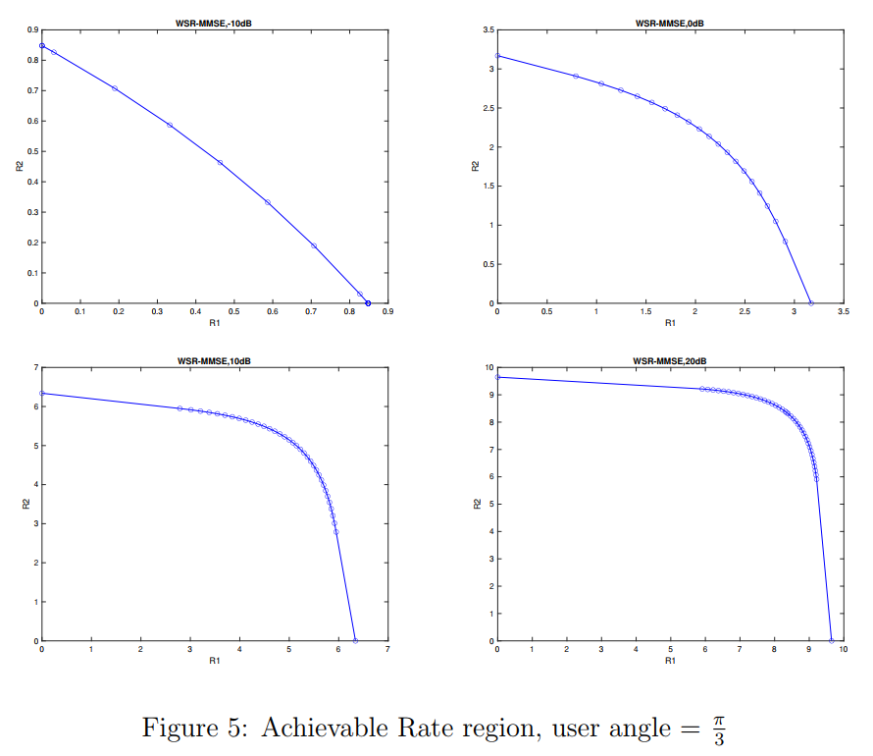
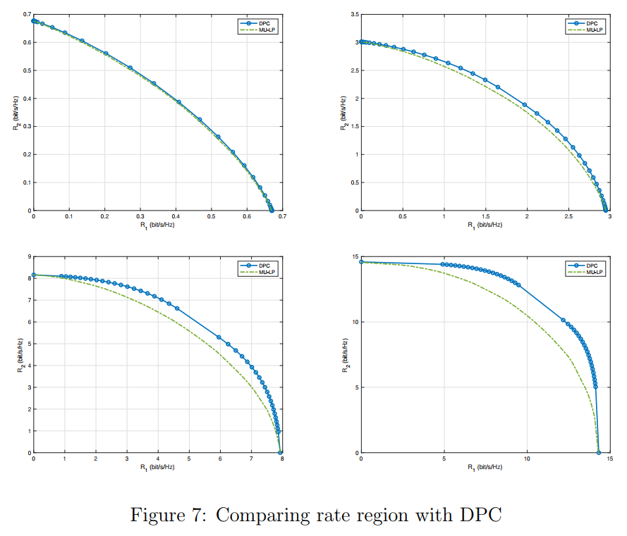
AO - Simulation results
Notes:
Figure 5

Slide 11
RS with PARTIAL csit
Sum Rate Maximization for Linearly Precoded Downlink Multiuser MISO Systems with Partial CSIT: A Rate-Splitting Approach
Assume instantaneous CSIT but come with error
CSIT errors – SNR: quality scaling factor
Maximized ergodic sum rate
Sample average approximation
Augmented WMSE method

Slide 12
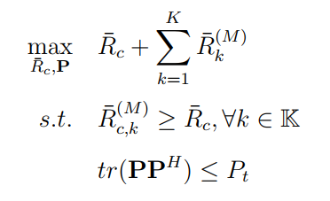
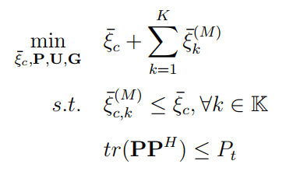
SAA and AWSMSE

Slide 13
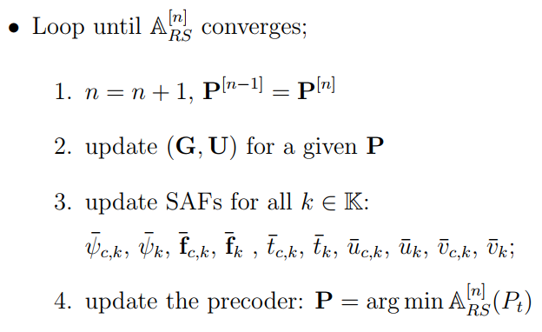
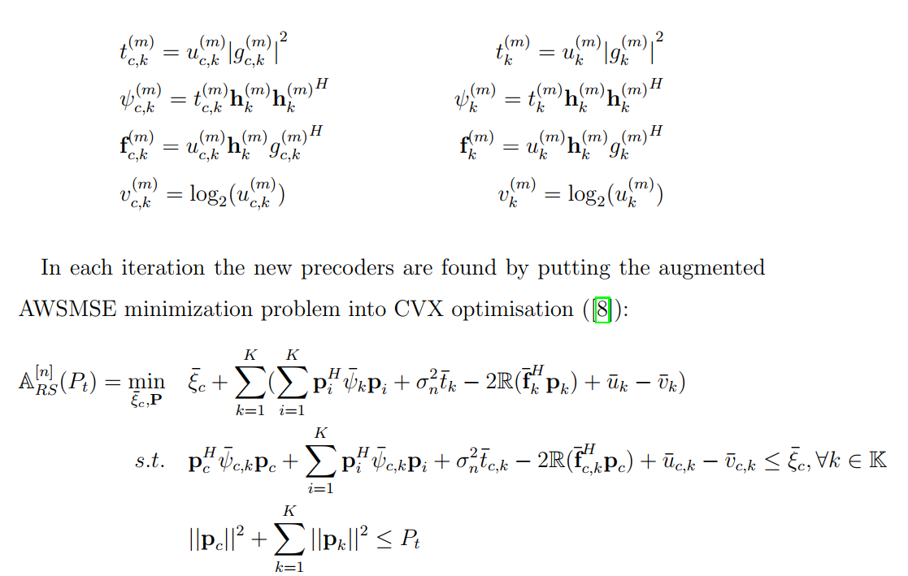
Alternating Optimization Again

Slide 14
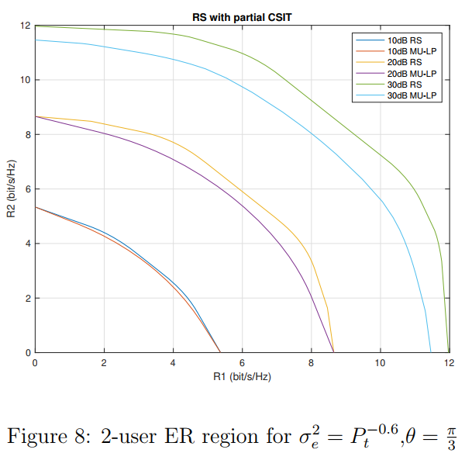
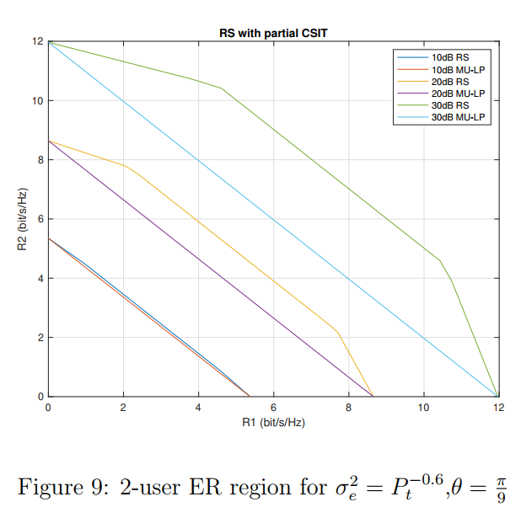
RS-PARTIAL CSIT: Simulation rESULTS
Notes:
Figure 8

Slide 15

Experiment on feasibility
QoS constraint
$R_{th} ≤R_{k}, k=1, 2$
E.g. Rth = 100, SNR = 10dB
CVX status: Solved, Infeasible
Per point: 100 test channels, 4 initialization methods, 2 ways to decode message

Slide 16
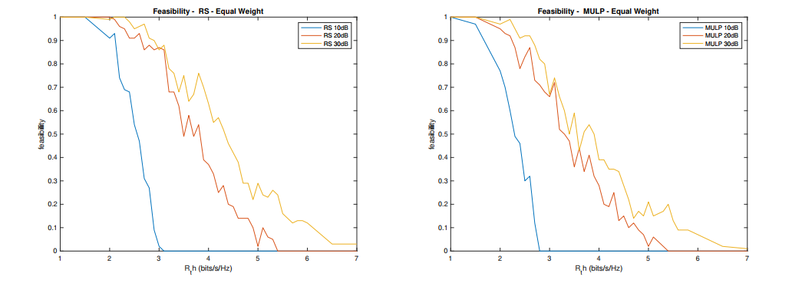
Simulation: changing SNR

Slide 17
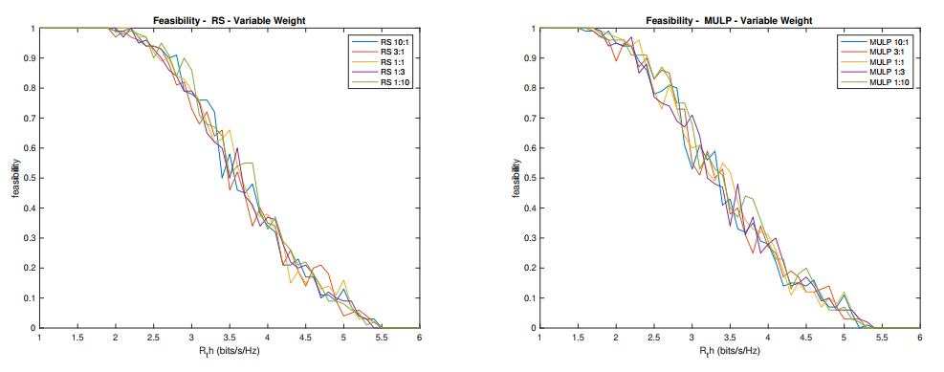
Simulation: variable weights

Slide 18
Reflection and conclusion
Research oriented project
Alternating Optimization
MATLAB and HPC
The final destination
Thank you very much.
Challenging questions ?

